Slide 1

EU27 Chemical Industry: Latest Developments
(Q4-2025)
To replace the background image:
1/Go to Slide Master (Menu “View”)
2/Right-click on the image
3/Select “Replace image…”
4/Close the Slide Master
Dr Moncef Hadhri
Chief Economist
mha@cefic.be

Slide 2
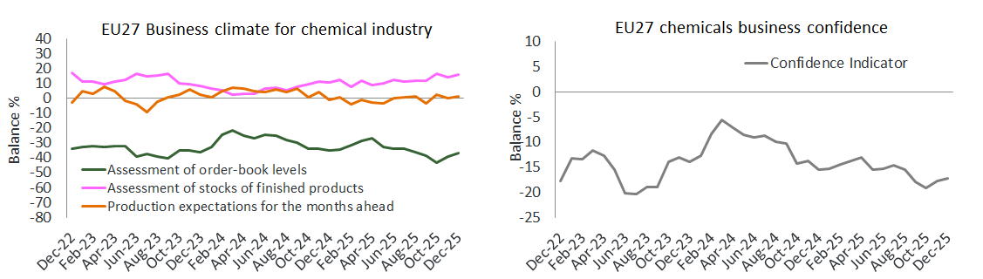
EU27 chemicals business confidence remains weak in 2025
Source: EU Commission business and consumer survey results: Answers obtained from the surveys are aggregated in the form of balances, constructed as the difference between the percentages of respondents giving positive and negative replies.

Slide 3
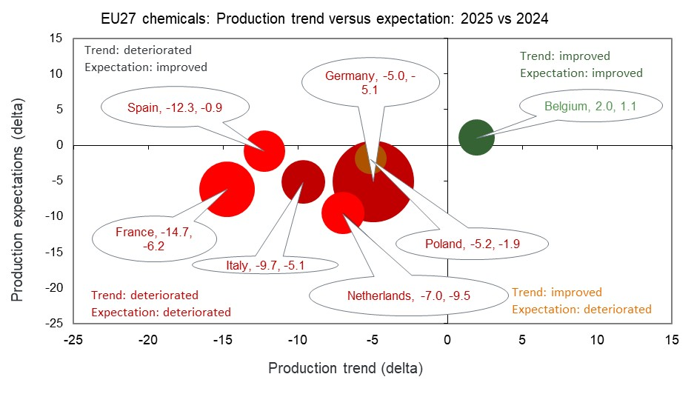
EU27 chemicals business mood deteriorated significantly in 2025
Source: EU Commission business and consumer survey results: Answers obtained from the surveys are aggregated in the form of balances, constructed as the difference between the percentages of respondents giving positive and negative replies. Size of bubbles is calculated by taking into account the country contribution of chemical sales for 2024.

Slide 4
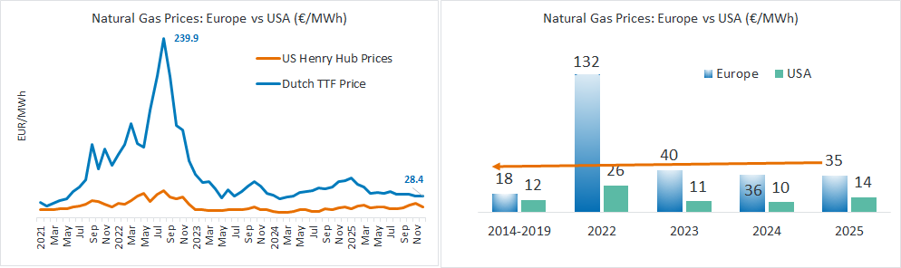
European gas prices remain above the pre-crisis levels
Gas prices in Europe in 2025: 1.9 times higher than pre-crisis levels (2014-2019)
Compared to the USA, the gas price in Europe 2025 is 2.5 times higher, leaving Europe at a competitive disadvantage.
Source ICE Dutch TTF Natural Gas Futures Historical Prices - Investing.com and INSEE Oil Prices data and ICIS

Slide 5
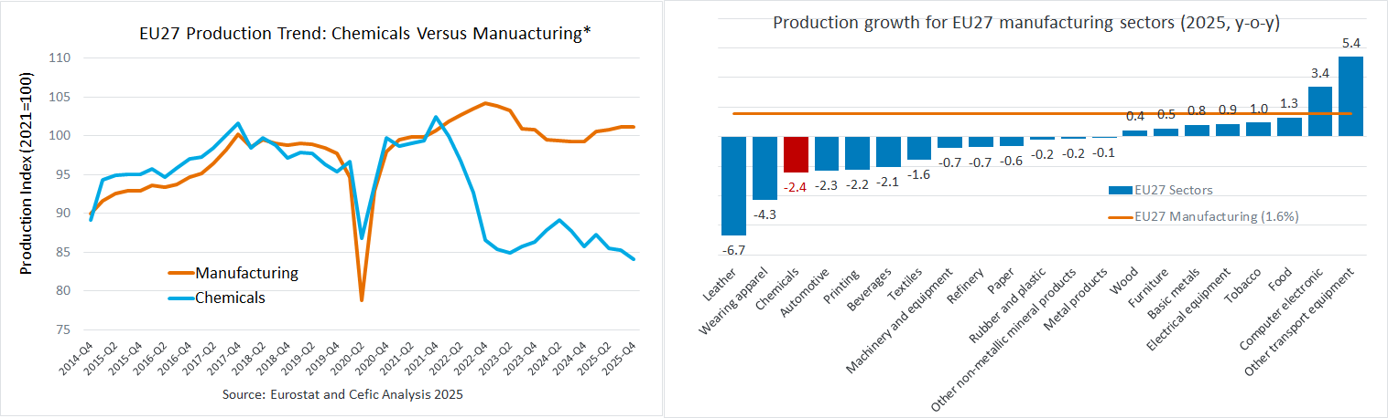
EU27 chemical demand: 2025 disappoints
*The disconnect between chemicals and other manufacturing sectors remains high.
  EU27 chemical output remains 11% below the pre-crisis levels (2014 to 2019)
Source: Cefic Analysis based on Eurostat Data, Nace 20 only

Slide 6
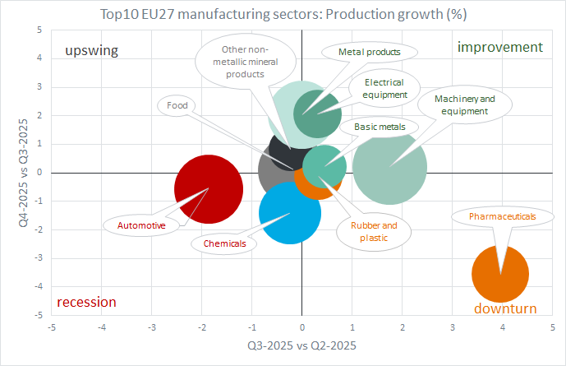
Q4-2025: EU chemicals and automotive sectors remain in crisis mode
Source: Cefic Analysis based on Eurostat Data, Size of bubbles is calculated by taking into account the contribution of added value by sector for 2024.

Slide 7
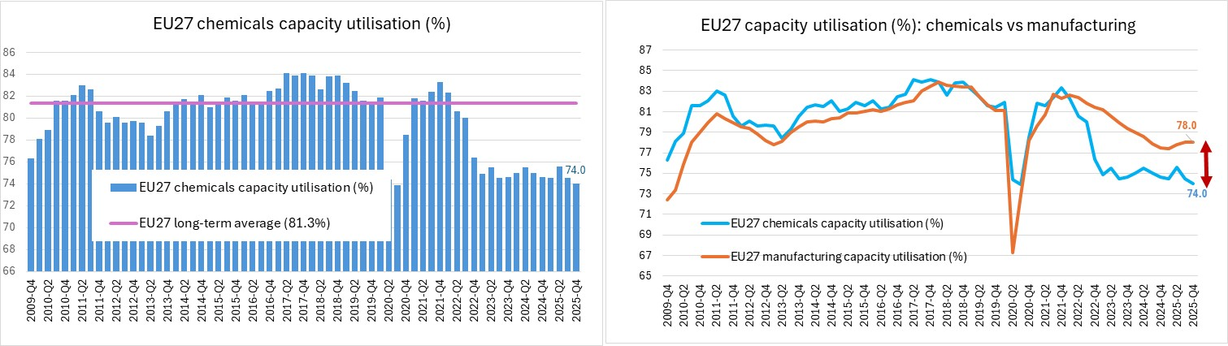
EU27 chemicals capacity utilisation remains steadily low
EU27 chemicals capacity utilisation remains well below
the long-term average
EU27 chemicals capacity utilisation remains well below
the manufacturing’s levels
  EU27 chemicals operating at 10.2% below pre-crisis capacity (2014–2019)
Source: Cefic Analysis based on Eurostat Data, Nace 20 only

Slide 8
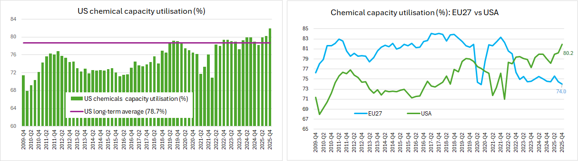
US chemicals capacity utilisation remains significantly high
US chemicals capacity utilisation slightly
increased in Q4-2025
US chemicals capacity utilisation remains well above
the long-term average (1991-2022)
Source: Cefic Analysis based on Eurostat Data

Slide 9
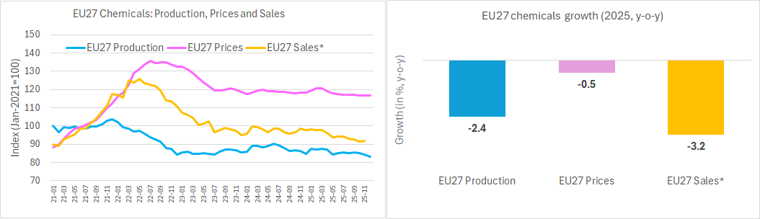
Weak demand continues to weigh on EU27 chemical sales*
Source: Cefic Analysis based on Eurostat Data, Nace 20 only, *2025 (Jan-Nov)

Slide 10
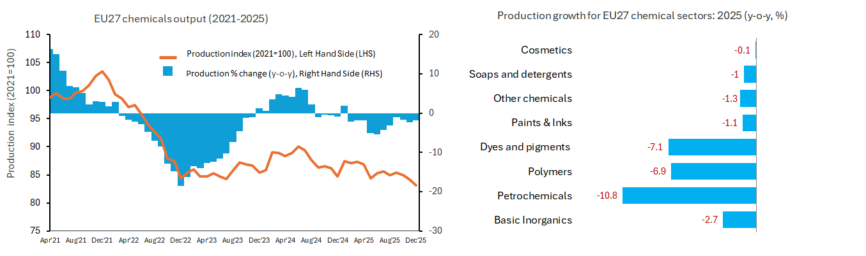
2025: EU27 chemicals production fell below 2024 levels in all segments
  With a 10.8 decline, petrochemicals are particularly impacted
Source: Cefic Analysis based on Eurostat Data, Nace 20 only

Slide 11
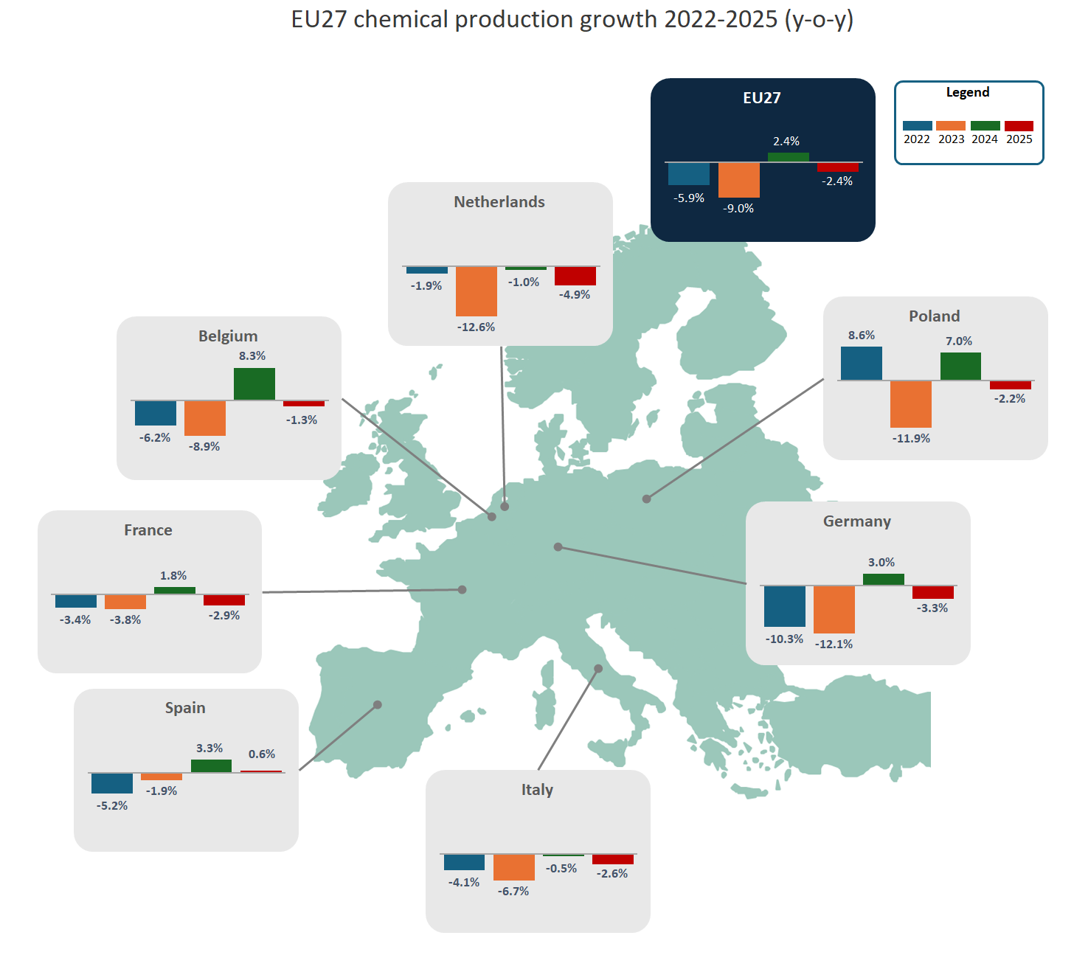
2025: EU27 chemicals production 2.4% below 2024 levels
Source: Cefic Analysis based on Eurostat Data, Nace 20 only

Slide 12
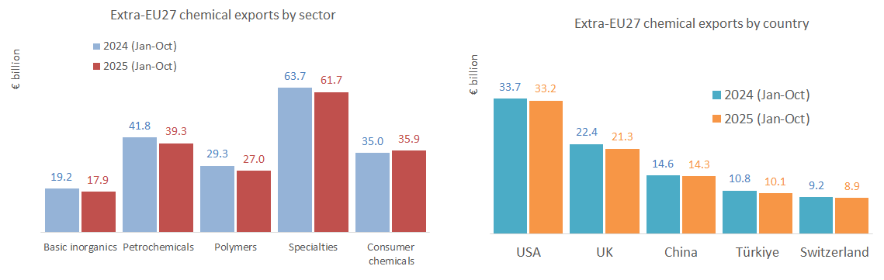
2025 (Jan-Oct): EU27 chemical exports value 3.8% below 2024 levels
Source: Cefic Analysis based on Eurostat Data, Nace 20 only

Slide 13
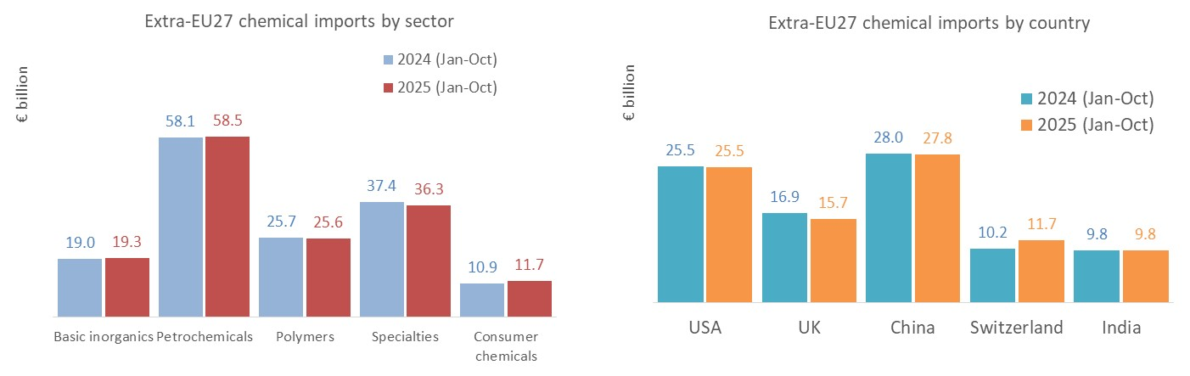
2025 (Jan-Oct): EU27 chemical imports value slightly above 2024 levels
Source: Cefic Analysis based on Eurostat Data, Nace 20 only

Slide 14
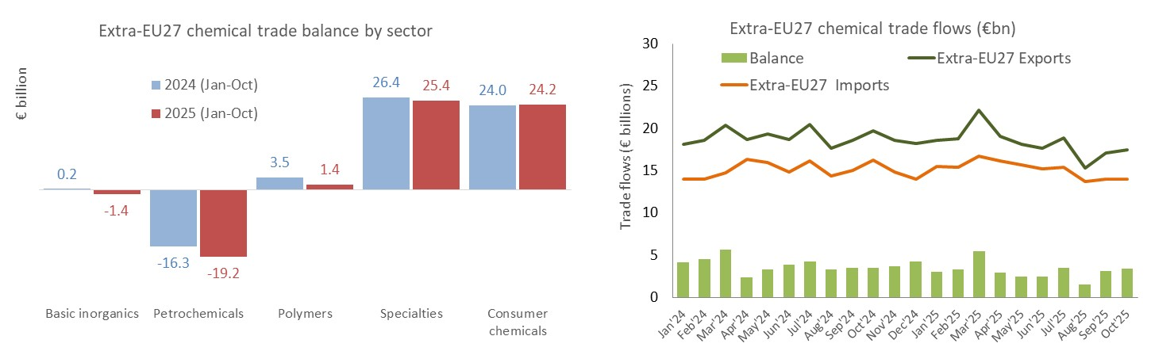
2025: EU27 trade surplus in value €7.3 bn below 2024 levels (Jan-Oct)
  Petrochemicals particularly affected
Source: Cefic Analysis based on Eurostat Data, Nace 20 only

Slide 15
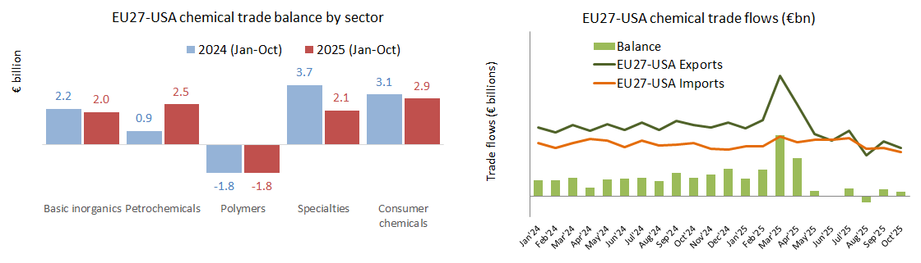
2025: EU27-USA trade surplus down by €0.4 bn compared to 2024 (Jan-Oct)
Source: Cefic Analysis based on Eurostat Data, Nace 20 only

Slide 16
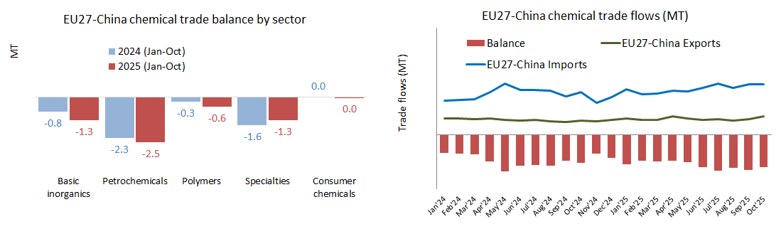
2025: EU27-China trade deficit up by 0.7 MT compared to 2024 (Jan-Oct)
Source: Cefic Analysis based on Eurostat Data, Nace 20 only

Slide 17
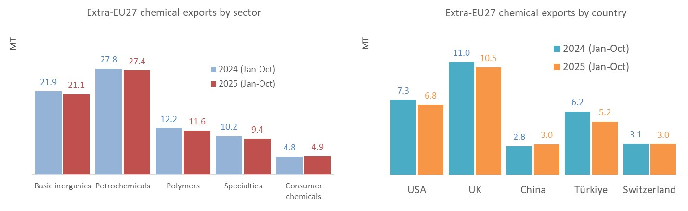
2025: EU27 chemical exports volume 3.3% below 2024 levels (Jan-Oct)
Source: Cefic Analysis based on Eurostat Data, Nace 20 only

Slide 18
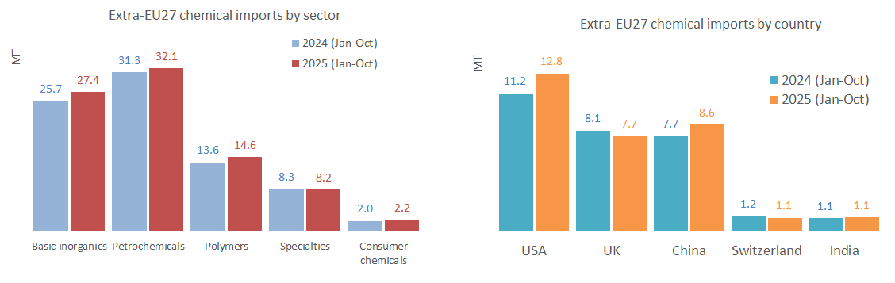
2025: EU27 chemical imports volume +4.3% above 2024 levels (Jan-Oct)
Source: Cefic Analysis based on Eurostat Data, Nace 20 only

Slide 19
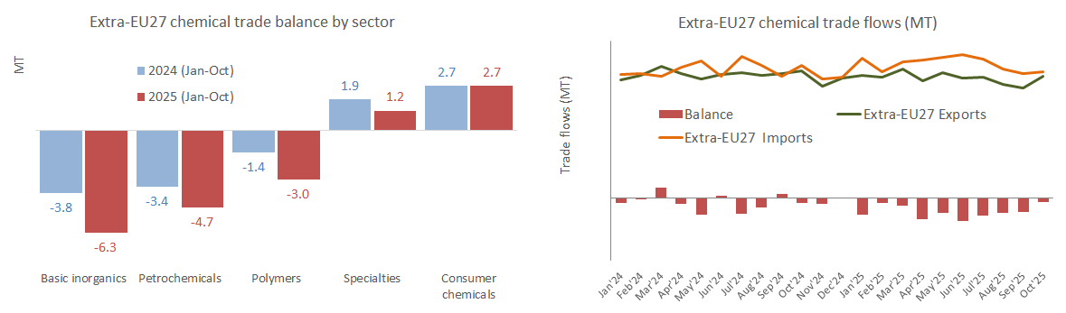
2025: EU27 trade deficit in volume above 2024 levels (Jan-Oct)
Source: Cefic Analysis based on Eurostat Data, Nace 20 only

Slide 20
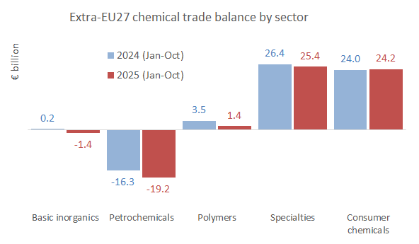
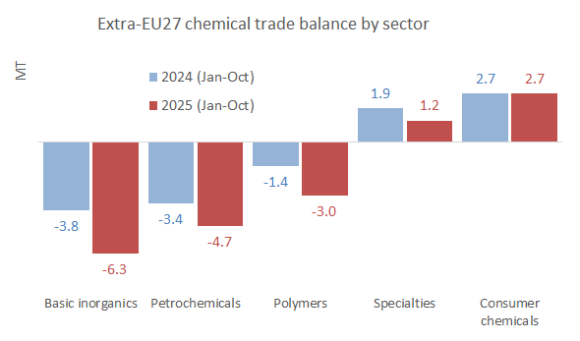
Trade balance summary: 2025 vs 2024
  Trade balance in value (€bn)
  Trade balance in volume (MT)
Source: Cefic Analysis based on Eurostat Data, Nace 20 only

